Slide 1
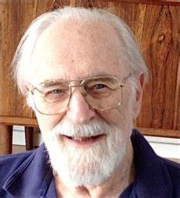

Karnaugh Map
Abdullah Alshabi 431109334
Ali Aldhlaan 431107785
Waleed Alharbi 431108129
Abdulmjeed Aldawish 431109432
Group 1454
Video link

Slide 2
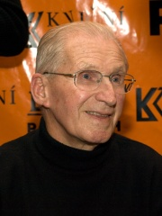
Dr. Maurice Karnaugh
An American physicist known for the Karnaugh map also known as the K-map; a method to simplify boolean algebra expressions.
K-MAP
• Karnaugh Mapping is used to minimize the number of logic gates that are required in a digital circuit.
• This will replace Boolean reduction when the
circuit is large.

Slide 3
Steps to solve expression using K-map
• Select K-map according to the number of variables.
• Identify minterms or maxterms as given in problem.
• For SOP put 1's in blocks of K-map respective to the
minterms (0's elsewhere).
• For POS put 0's in blocks of K-map respective to the
maxterms(1's elsewhere).
• Make rectangular groups containing total terms in power of two like 2,4,8 ..(except 1) and try to cover as many elements as you can in one group.
• From the groups made in step 5 find the product terms and sum them up for SOP form.

Slide 4
RULES
• Groupings can contain only 1s; no Os.
• Groups can be formed only at right angles; diagonal groups are not allowed.
• The number of 1s in a group must be a power of 2 - even if it contains a single 1.
• The groups must be made as large as possible.
• Groups can overlap and wrap around the sides of the Kmap.
• Use don't care conditions when you can.

Slide 5
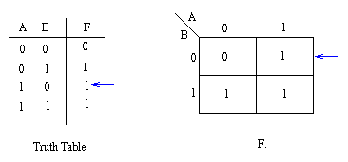
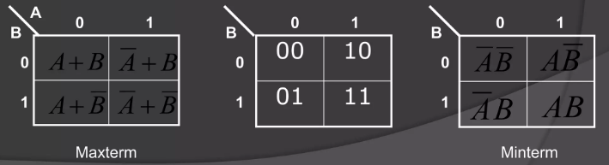
Two variable Map
For the case of variables, we from a map consisting of 2² = 4 cells as shown in the figure
F= A + B

Slide 6
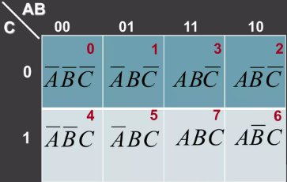
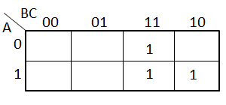
Three variable Map
For the case of variables, we from a map consisting of 2³ = 8 cells as shown in the figure
F= AB + BC

Slide 7
Presentation Sources
https://www.ithistory.org/honor-roll/dr-maurice-karnaugh
Introduction of K-Map (Karnaugh Map) - GeeksforGeeks
Lecture 5
Abdullah Alshabi 29%
Ali Aldhlaan 24.5%
Waleed Alharbi 22%
Abdulmjeed Aldawish 22%

